Slide 1
UNICORN COMPANIES
AN EXPLORATORY DATA ANALYSIS

Slide 2
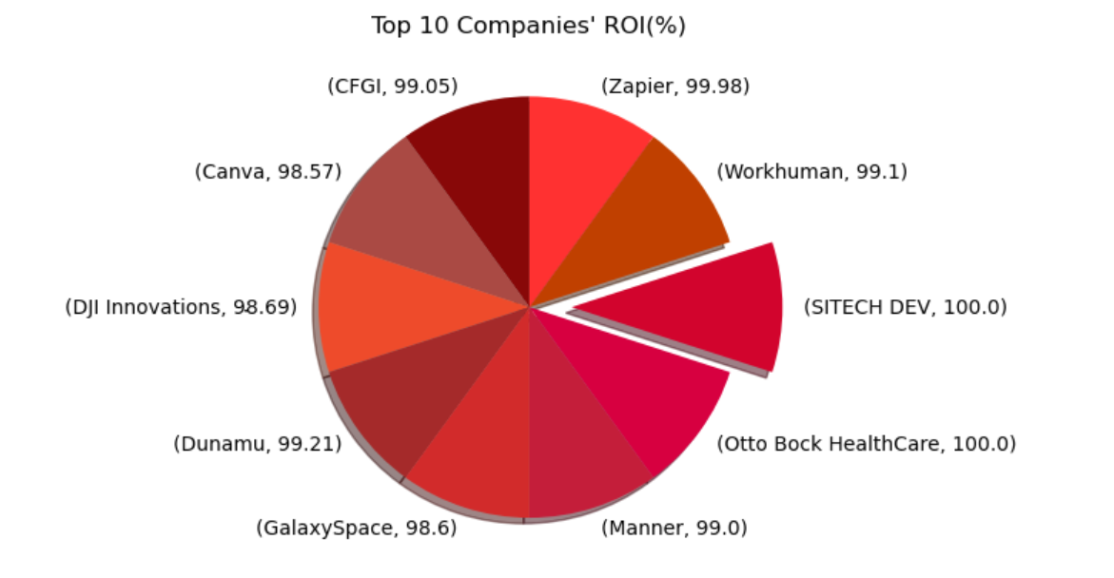
TOP 10 ROI OF UNICORN COMPANIES(%)
Observation:
- Otto Bock Healthcare and SITECH DEV came out on top in terms of Return on Investment recorded (100% : at $0 funding). That being said, there are uncertainties around the latter as its funding was previously recorded as unknown. But with further research, it was speculated that it is yet to receive any funding till date (Ref: Tracxn Technologies Private Limited, May 31, 2021)

Slide 3
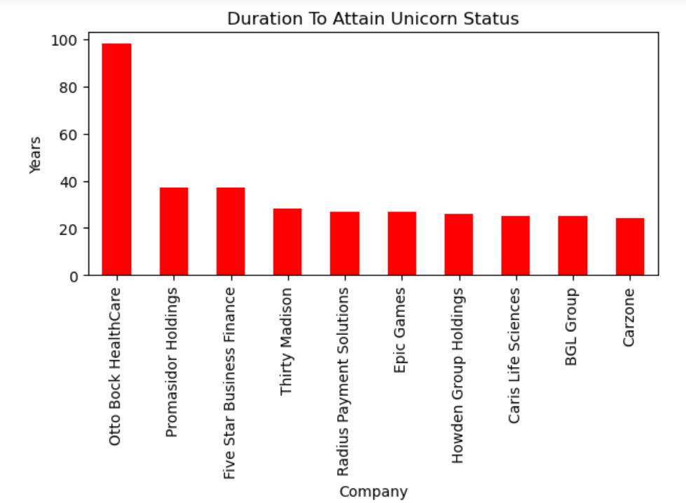
TIME TAKEN TO ATTAIN UNICORN STATUS
Observation:
- Some companies took quite a long time to attain the level of a Unicorn Company (USD 1 billion valuation), for example; Otto Bock HealthCare took 98 years to achieve this feat but Avant didn't take up to a year. There are reasons for the timing in being refered to as a Unicorn Company:
- 1. Tech is the fastest route to success and achieving the tag of a unicorn for most companies in this new age. Tech companies nowadays attain billion dollar valuation within a year after their inauguration - Avant for example.
- 2. Pertaining to the term "Unicorn" literally; it was not used in referring to billion dollar companies, not until 2013, when it was first coined by a venture capitalist Aileen Lee. The first Billion dollar company was the United States Steel Corporation in 1901 at a valuation of USD 1.4 billion, but it wasn't referred as a Unicorn at that time.

Slide 4
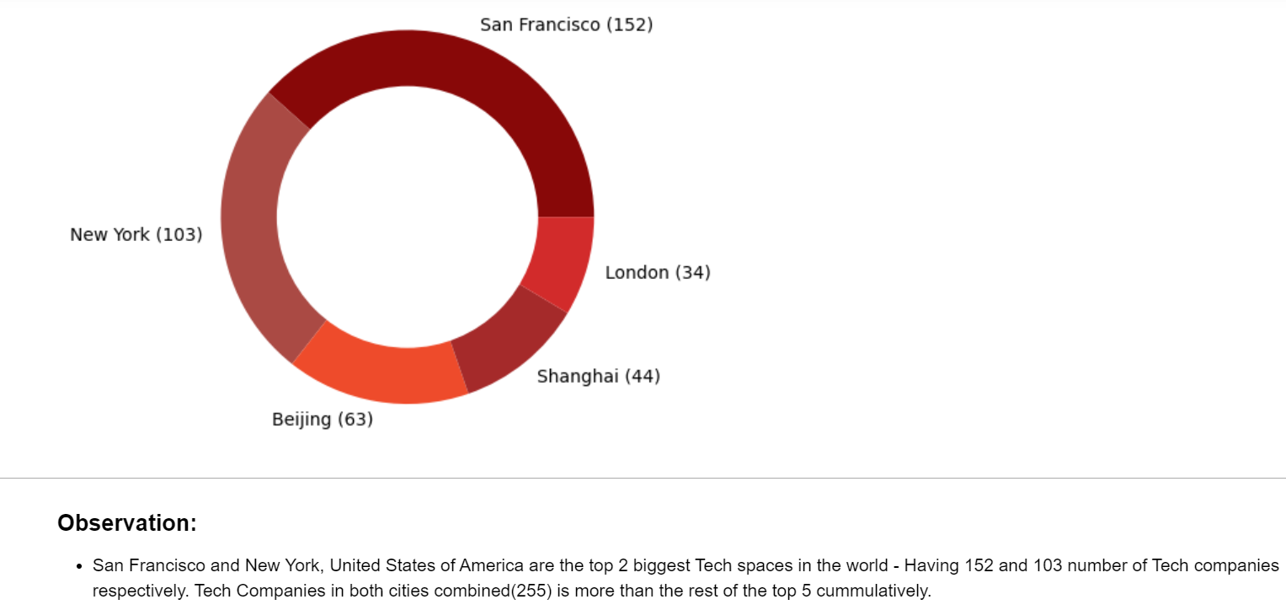
Top 5 Tech Hub Cities

Slide 5
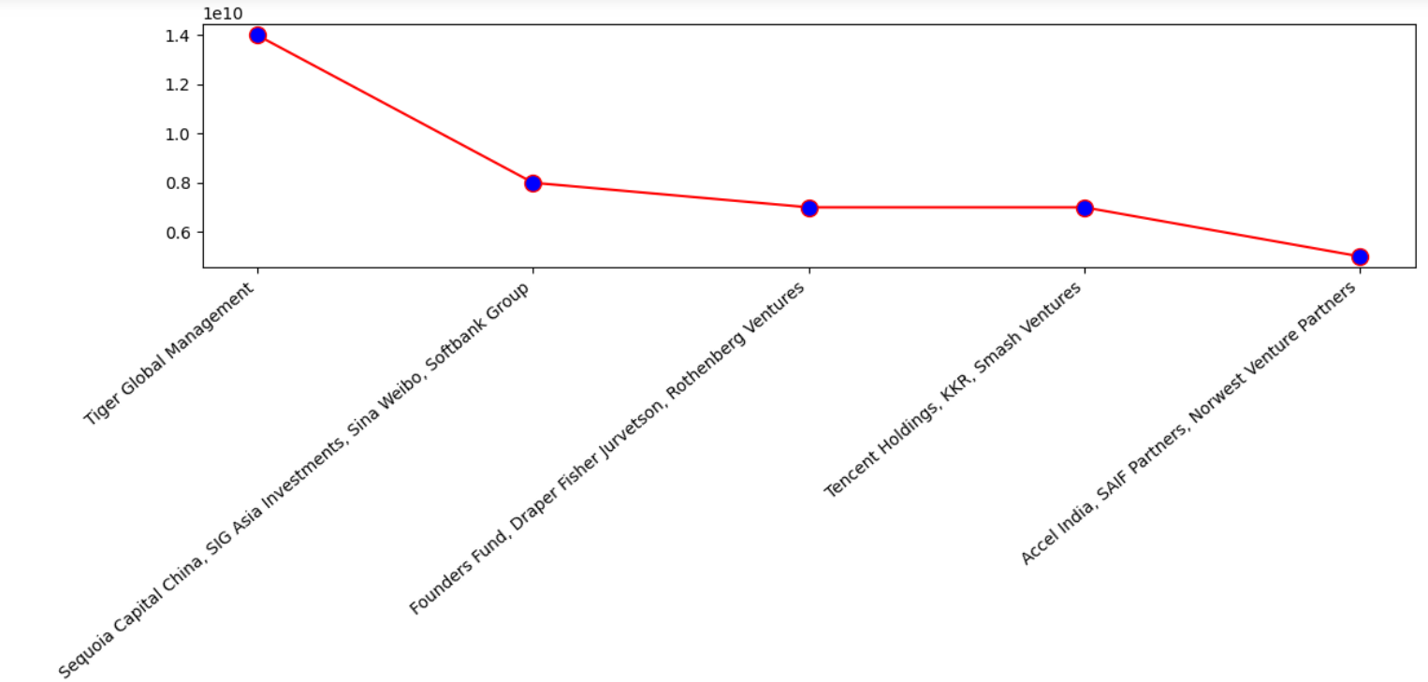
INVESTORS WHO INVESTED THE MOST
Observation:
- Tiger Global Management are the Top Spenders in the list of investments to the Unicorn Companies, at a staggering sum of USD14 Billion. They are just directly atop the most frequent investors in the list; Sequoia Capital China.

Slide 6
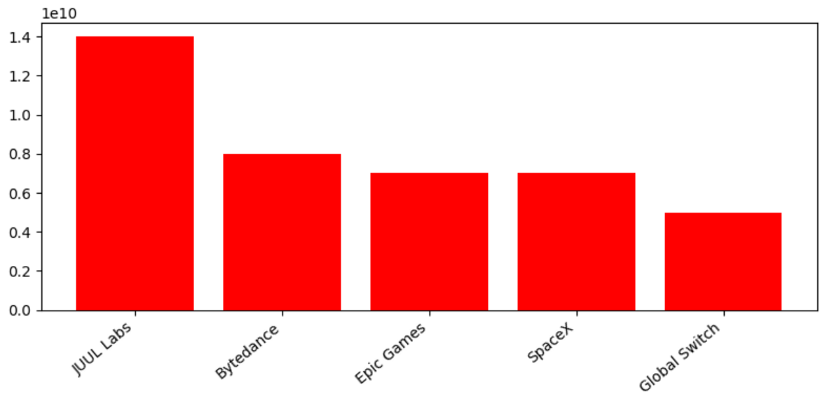
COMPANIES THAT RECEIVED THE MOST FUNDING AND THEIR R.O.I
Observation:
- JUUL Labs had the most funding at USD14 Billion, but only pulled off a 64% return on investment.
- Bytedance - makers of the popular Social Media Platform; 'Tik Tok' - on the other hand had about USD8 Billion in funding and managed to produce a whooping 95% return on investment. Making it the Company with the highest ROI on this list of most funded Companies.

Slide 7
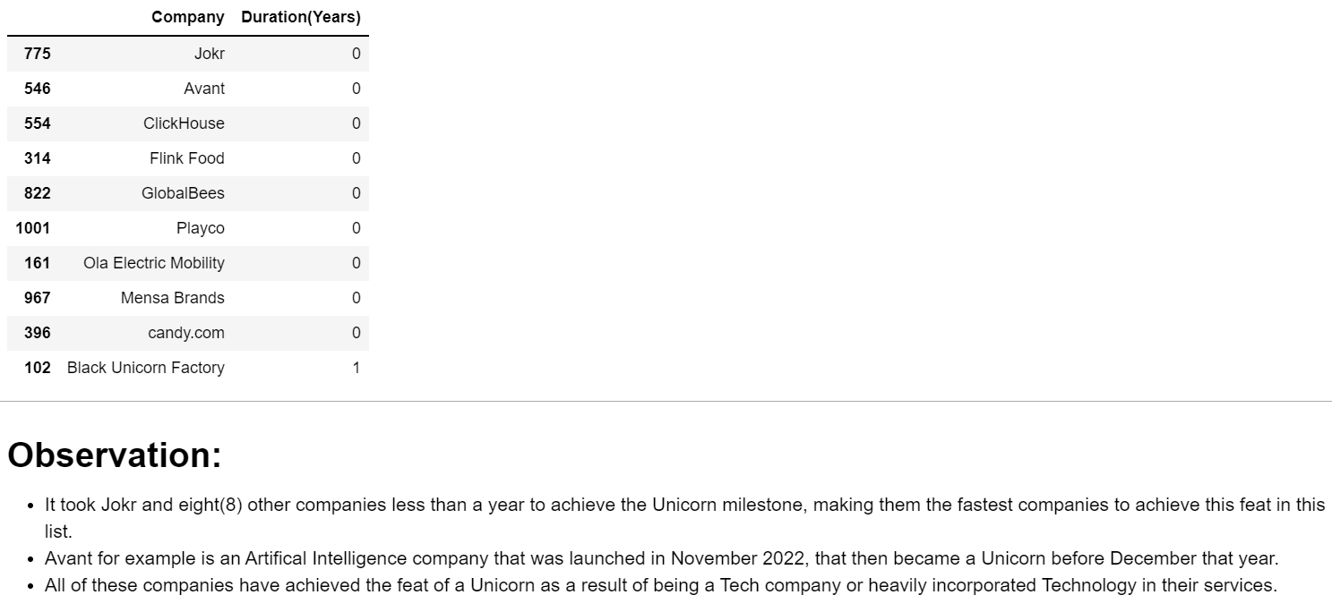
FASTEST COMPANIES TO ATTAIN UNICORN STATUS

Slide 8
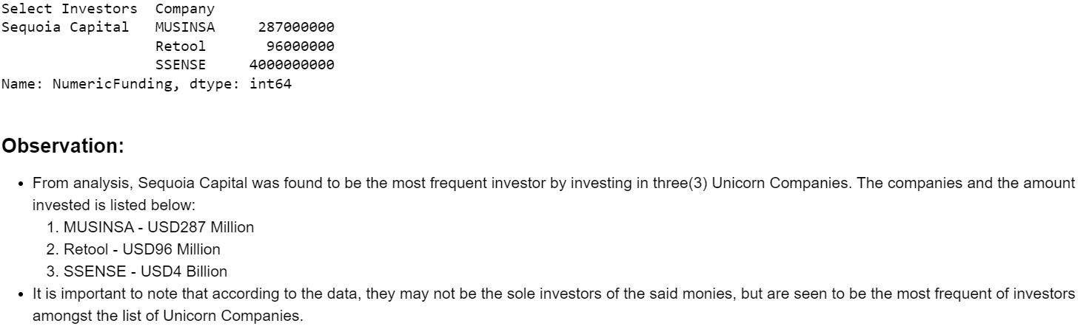
THE MOST FREQUENT INVESTOR IN UNICORN COMPANIES AND THEIR INVESTMENT(2 INSIGHTS IN 1)

Slide 9
RECOMMENDATIONS:
- Augment operational efficiency: They have to evaluate the company's operational processes and identify areas where efficiency can be improved upon. This can involve optimizing resource allocation and reducing unnecessary expenses. By improving the operational efficiency, the company can maximize the utilization of its resources and then potentially increase their profit.
- Assess investments: Review the company's investment decisions and analyze the factors contributing to the lower ROI. Evaluate whether the investments were made in viable and strategic initiatives. If necessary, adjust the investment strategy to focus on areas that have the potential to deliver higher returns.

